Slide 1

Professional Practices lecture # 1 Instructor: Muhammad asad department of computer science

Slide 2
COURSE OVERVIEW
- Professional Practices under the category general education courses, Course designed to teach students how to think and act as entrepreneurial and profession-wise, after graduating.
- By the completion of this course, the students should able to…
Know how a business and professional environment work.
Adhere his/her responsibility according to profession and organization.
Know the standards / tools / models / polices / principles to analyze information for decision making.

Slide 3
Key Learning Point :-
- What is an organization.
- Organizational culture.
- Organization external environment.

Slide 4

WHAT IS ORGANIZATION?
An organization is a group of individuals working together to achieve one or more objectives. The common features…
1: They are composed of individuals and groups of individuals
2: They are concerned with achieving collective goals
3: They consist of different functions (Need to be coordinated)
Not a random group of people who come together by chance.
They deliberately come together to accomplish certain goals that its members would be

Slide 5
We define organization as…
“A entity which is goal orients and deliberately structured”
THE ORGANIZATION'S OBJECTIVES
1: Fulfill its customers needs and wants with goods and services
2: Make a profit for shareholders
3: Keep Stakeholders happy
SHAREHOLDER VS STAKEHOLDER
Person who owns an equity stock in the company (Ownership stake in the company).
A stakeholder is an interested party in the company’s performance for reasons.

Slide 6
COMPONENTS OF ORGANIZATION
Task/Goal is a mission or purpose of the existence of an organization - That is accomplished by producing certain goods and services as an output.
People are workforce or human part of organization that performs different operations in the organization.
Deliberate Structure is the basic arrangement of people in the organization.
Technology is the intellectual and mechanical processes used by an organization to transform inputs into products.

Slide 7
TYPES OF ORGANIZATION
1: INFORMAL ORGANIZATION
No predefined rules and procedures that establish work relationships among the employees.
Undefined structures or lines of communication among the employees.
Positive point speed up communication & procedure --- Negative point lower the privacy (secret information leak out).

Slide 8
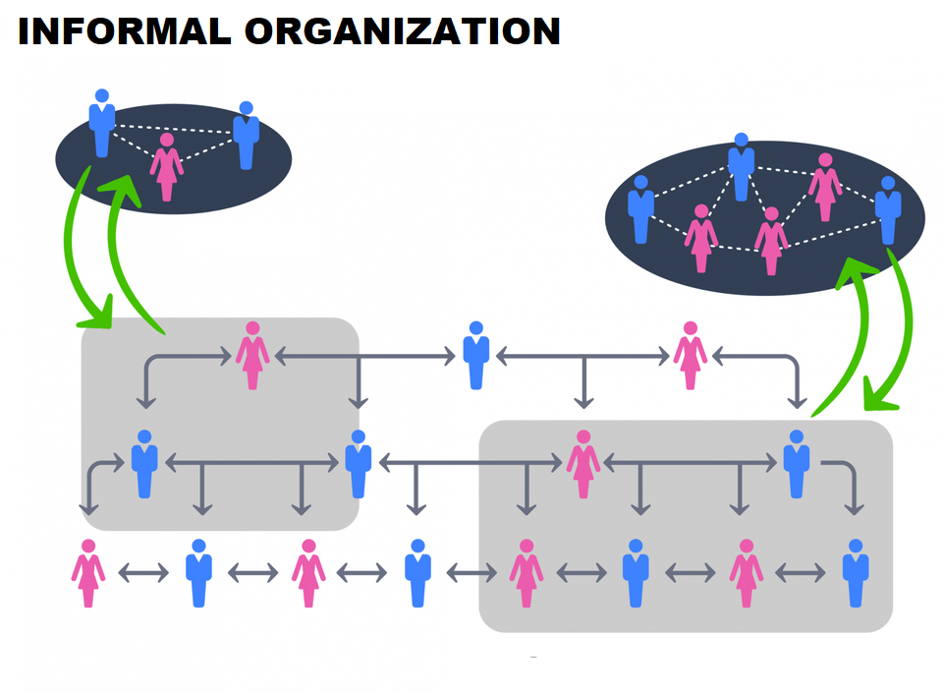

Slide 9
2: FORMAL ORGANIZATION
Certain rules and procedures that establish work relationships among the employees.
A systematic flow of interactions among the employees.
A clear boundary of authority and responsibility.
Positive point privacy (secret information secure) --- Negative point slow down communication & procedure.

Slide 10
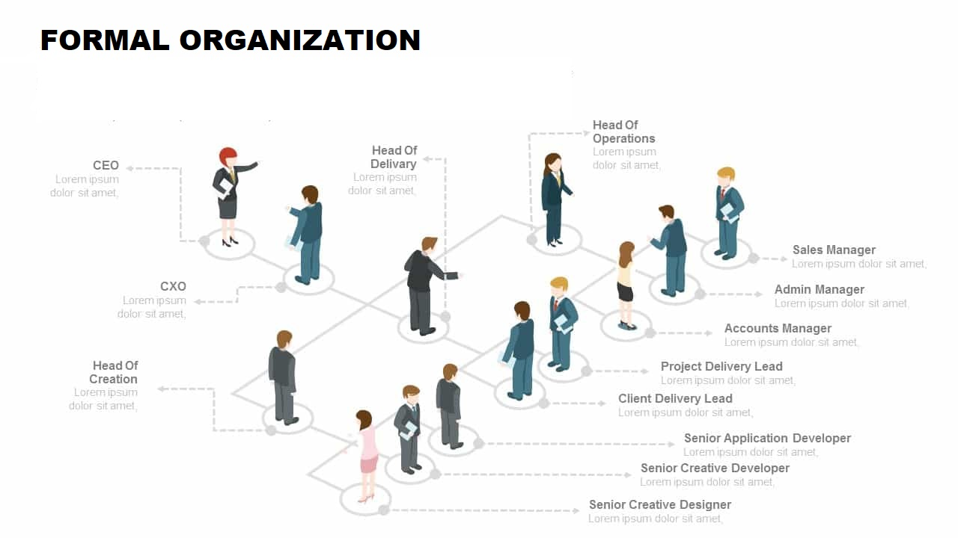

Slide 11
ORGANIZATION CULTURE
(Within Organization)
The shared values, principles and traditions.
The ways of doing things that influence the way organizational members act and that distinguish the organization from other organizations.
“How things are done around here”
In most organizations, these shared values and practices have evolved over time and determine.

Slide 12
Culture is a perception It’s not something that can be physically touched or seen, but employees perceive it on the basis of what they experience within the organization.
Culture is descriptive It’s concerned with how members perceive the culture and describe it, not with whether they like it.

Slide 13
STRONG CULTURES
(The key values are deeply held and widely shared)
Values widely shared
Culture conveys consistent messages about what’s important.
Most employees can tell stories about company history or heroes.
WEAK CULTURES
(The key values are not deeply held and widely shared)
Values limited to a few people—usually top management.
Culture sends inconsistent messages about what’s important.
Employees have little knowledge of company history or heroes.

Slide 14
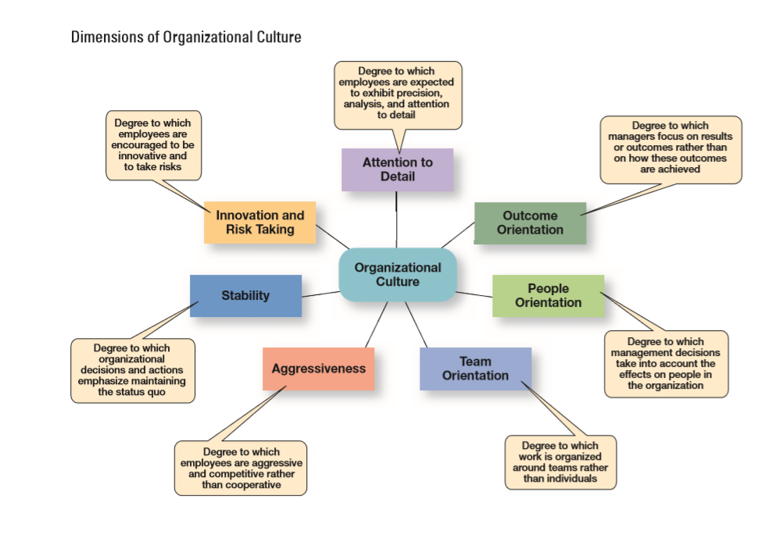

Slide 15
EMPLOYEES LEARN CULTURE
The development of a distinct organizational culture is essential for boosted employee loyalty and brand positioning. Different cultures attract different types of people to the organization, contributing to its overall composition.
RITUALS
Repetitive sequences which emphasize an organization's values and core practices. Repeatedly enacting these events is essential for the embedment of what is important into the mindsets of employees, reflecting the type of work culture the organization withholds.

Slide 16
MATERIAL SYMBOLS
Symbols serve as a representation of an organization's culture, further instill a sense of identity and drive in employees. They traditionally communicate with those in the organization through unspoken messages.
LANGUAGE
Language is often used by organizations as a way to characterize a particular culture and identify those within it.
Having a specific language preserves the particular culture and allows employees to feel more included and surrounded with support. (Short word code)

Slide 17
STORIES
Organisational narratives or events relating to founders, conquers, successes and failures, building a stronger connection between the employee and the organization (Re-telling of stories, as is what employees should and should not do).
Organizational heroes who perform in an exemplary manner, of which other employees should follow suit (as role models, continual guidance of employees in a positive direction).

Slide 18

Cultural values and practices have evolved over time and determine. Click on above video and Watch how the negative practice of one employee became the part of organization culture.

Slide 19
ORGANIZATION EXTERNAL ENVIROEMENT
(Outside Organization)
The factors and forces outside the organization that affect its performance.
SPECIFIC ENVIROMENT: External factors and forces that direct impact on organization performance.
— Customer — Supplier
— Competitor — Pressure Group

Slide 20
GENERAL ENVIROMENT: Factors and forces that generally impacting everyone in an industry or market in a similar way…
— Political / Legal — Social
— Economic — Demographic
— Technological

Slide 21

ANY QUESTION
You can contact me at: asadali@uosahiwal.edu.pk
Your query will be answered within one working day.

